Slide 1
EDA For The Retailer On BLACK FRIDAY
L I M I T E D T I M E O N L Y
BLACK FRIDAY
SI 618: Project 2
50% OFF
Data Science
Yonnie Chan / yonniech
Dec. 8, 2022
SALE SALE SALE SALE SALE SALE SALE SALE SALE SALE SALE SALE SALE SALE
Notes:
My name is Yonnie Chan
The topic of my project 2 is EDA for the retailer on black friday

Slide 2
RESEARCH QUESTIONS
Who are our core customers?
01
BLACK FRIDAY BLACK FRIDAY BLACK FRIDAY BLACK FRIDAY BLACK
What are our best-sellers?
02
Clustering for customer segments?
03
Notes:
For retailers, it would be prodigal business practices if they make a wrong promotion for wrong customers or products. Conducting Black Friday sales analytics helps us to get a better understanding of the customer, especially during the season, to obtain further insights for retailers to develop better data-driven strategies for the future.
My main research questions for this project are:
Who are our core customers
What are our best-selling products
How could we cluster our customer segments

Slide 3
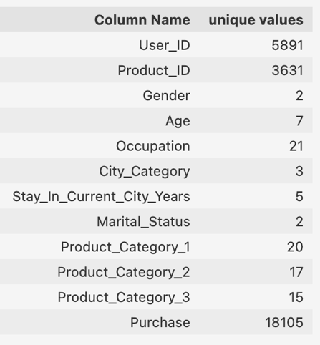
DATASET
Contains three main aspects:
Customer demographics
Product details
Total purchase amount
SALE SALE SALE SALE SALE SALE SALE SALE SALE SALE SALE SALE SALE SALE
BLACK FRIDAY BLACK FRIDAY BLACK FRIDAY BLACK FRIDAY BLACK
Notes:
For this project, I had access to the dataset available on Kaggle from a retail company, called ABC Private Limited.
The dataset contains information includes different aspects of customer, product details, and total purchase amount

Slide 4
75.3%
39.9%
59.1%
GENDER
AGE
MARTIAL
SALE SALE SALE SALE SALE SALE SALE SALE SALE SALE SALE SALE SALE SALE
CORE CUSTOMER
Male
26-35
Single
BLACK FRIDAY BLACK FRIDAY BLACK FRIDAY BLACK FRIDAY BLACK FRIDAY
Notes:
For the number of transactions, it is salient that the stores got more male customers (75.3% male and 24.7% Female). Up to 40% of purchase records are from 26-35 age group Also, Unmarried customers count more than married customers.

Slide 5
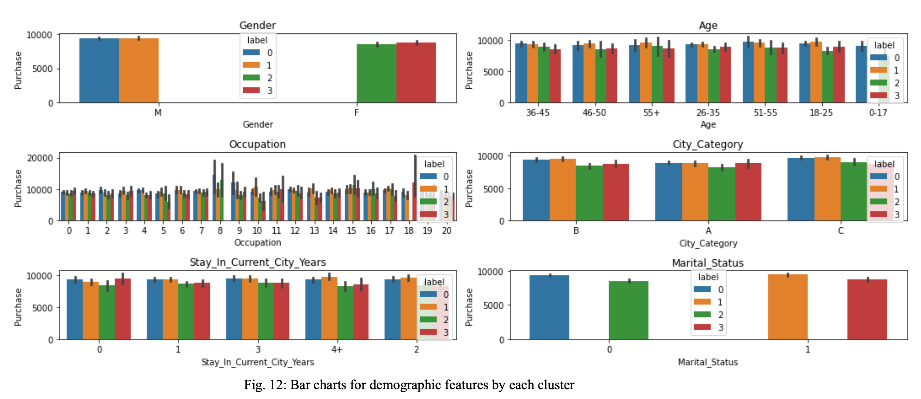
BLACK FRIDAY BLACK FRIDAY BLACK FRIDAY BLACK FRIDAY BLACK
Notes:
To figure out the exact customer segment we have, I conducted a K-means clustering.
After clustering, I generated six bar charts for each demographic characteristic for four clusters. Then we could get a segment profile for each cluster.
We could observe cluster 0, which is exactly our core customers should be our main target for future campaign.

